Slide 1

OP-EDS FOR ACADEMICS WORKSHOP
Monika Sengul-Jones & Alison Durran
March 3, 2026 and March 5, 2026

Slide 2
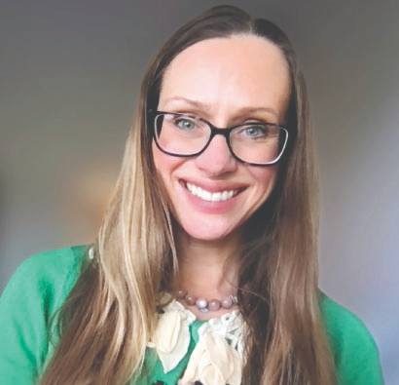
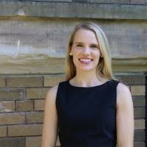

Monika Sengul-Jones, PhD
Director of Strategy and Operations Society + Technology at UW | Hostec by the UW Tech Policy Lab
mmjones@uw.edu
THANKS FOR BEING HERE!
Alison Durran, JD/MPH
Research to Policy Fellow, Center for an Informed Public
adurran@uw.edu

Slide 3

Why Op-Eds for Academics?

Slide 4
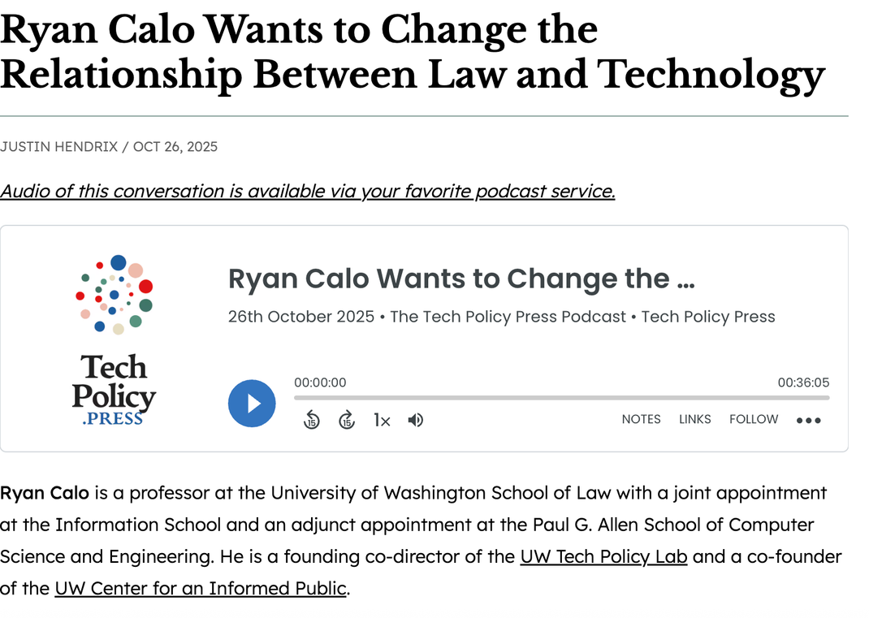
Ryan Calo (Law and Information, UW Seattle)
01
How did you write an op-ed about your research for a new audience?
02
Who were you trying to reach?
03
What did you learn?
04
What academic habits do you need to let go of?
05
One piece of advice?

Slide 5


What is ONE idea you have?
What is your opinion on the idea?

Slide 6

Evidence
Stats, reports, expert quotes, academic research, historical examples, policy, and first-hand experience

Slide 7
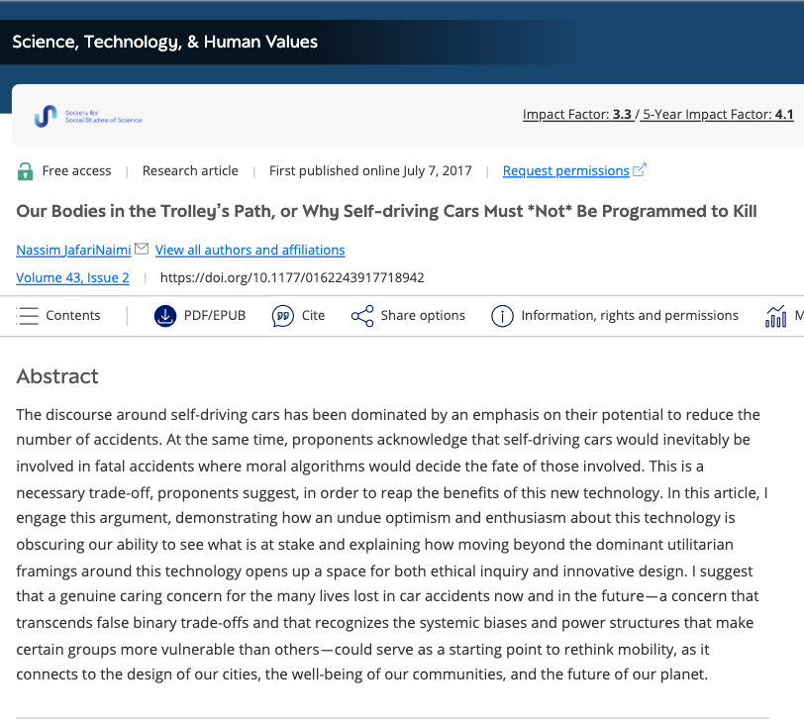
JafariNaimi, N. (2018). “Our Bodies in the Trolley’s Path, or Why Self-driving Cars Must *Not* Be Programmed to Kill,” in Science, Technology, & Human Values.
https://journals.sagepub.com/doi/full/10.1177/0162243917718942?

Slide 8
It’s not easy to write about your academic research for a general audience ...
Before
“The 1907 case of Lewis v. Amorous is a telling precedent. Mrs. R. M. Lewis suing after the death of her son, Branch Lewis, Jr. confronted a legal tide already turning away from systemic accountability. The parallels are striking. According to the pleadings, children were skating in the streets and Branch Lewis, Jr. was watching the other children skate; he then “started across the street” when he was struck. The judge ultimately put the blame on the “negligent” driver who, as it happened, was not the owner.”
After
“In 1905, three years before Ford released its Model T, a car struck and killed Branch Lewis Jr. His mother sued, only to confront a legal system already shifting away from systemic accountability. The 1907 ruling in Lewis v. Amorous set an important precedent. According to the pleadings, children were skating and playing in the street, and Branch Lewis Jr., watching the others, “started across the street” when he was struck. The court ultimately placed responsibility solely on the “negligent” driver, who, as it happened, was not the car’s owner.”
Nassim Parvin thanks Stefan Milne for this editorial suggestion!

Slide 9
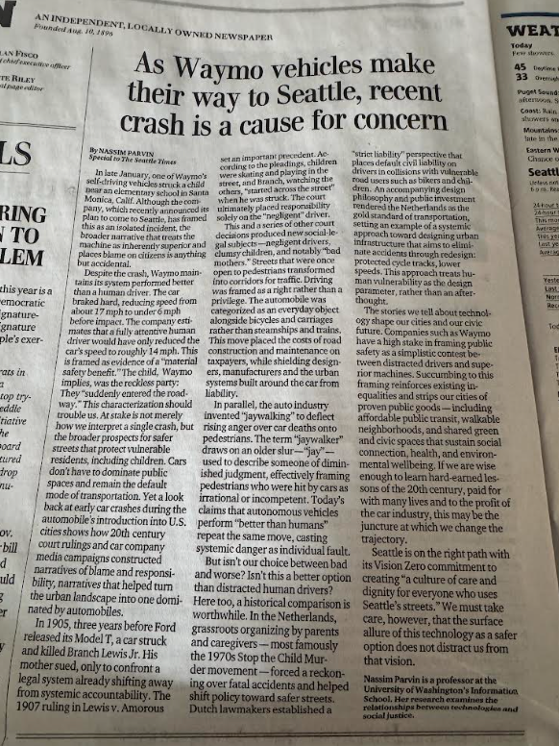
https://www.seattletimes.com/opinion/driverless-technology-is-portrayed-as-safer-but-at-whose-expense

Slide 10
Evidence
List two to three examples of research to support your opinion

Slide 11

The “Hook”

Slide 12
Choose and Use a Hook
Trump and Netanyahu Are Doing the Free World a Favor
News Study Finds Ozempic Protects the Heart
Anthropic Refuses Pentagon’s Proposal to Loosen AI Guardrails
Trump Directs the Pentagon to Release Files Related to UFOs and Aliens

Slide 13

The “To Be Sure ...”

Slide 14
Techniques of the ‘To Be Sure’
  Acknowledge and dismiss
  Validate and transcend
  Give a personal caveat
“But isn’t our choice between bad and worse? Isn’t this a better option than distracted human drivers? Here too, a historical comparison is worthwhile. In the Netherlands, grassroots organizing by parents and caregivers — most famously the 1970s Stop the Child Murder movement — forced a reckoning over fatal accidents and helped shift policy toward safer streets. Dutch lawmakers established a “strict liability” perspective that places default civil liability on drivers in collisions with vulnerable road users such as bikers and children. An accompanying design philosophy and public investment rendered the Netherlands as the gold standard of transportation, setting an example of a systemic approach toward designing urban infrastructure that aims to eliminate accidents through redesign: protected cycle tracks, lower speeds. This approach treats human vulnerability as the design parameter, rather than an afterthought.
The stories we tell about technology shape our cities and our civic future.”
Nassim Parvin’s Op-Ed from 2026

Slide 15
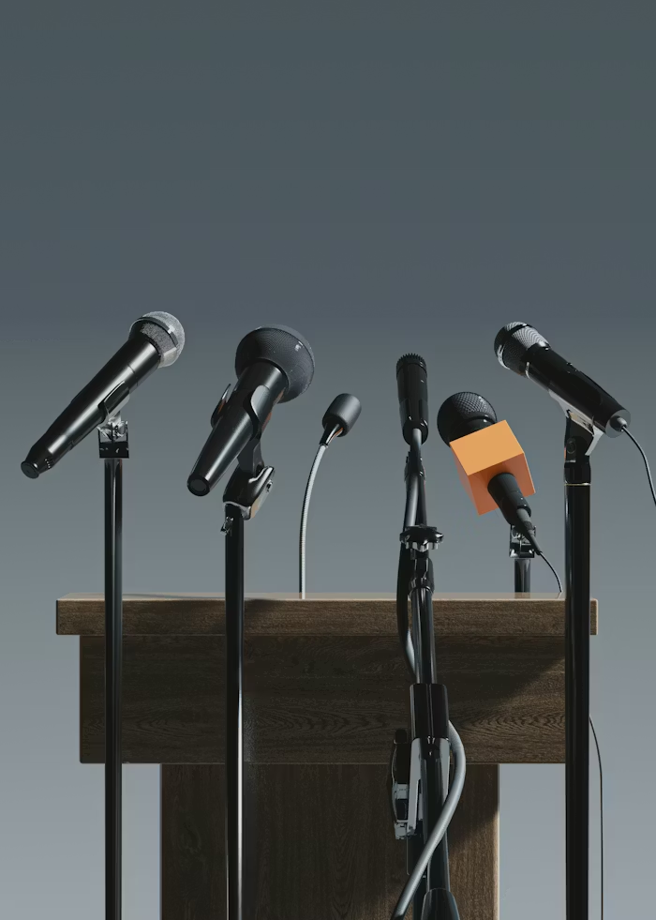
Getting the Op-ed Out! | Submissions

Slide 16
Example: Submit on spec email
Dear Seattle Times Opinion Editors,
I am submitting the attached op‑ed essay for your consideration for publication in The Seattle Times. The essay is prompted by the Waymo crash near a Santa Monica elementary school, and in anticipation of Waymo's arrival to Seattle streets soon. It interrogates the popular story that autonomous vehicles now outperform human drivers. It looks at the history of how we’ve assigned responsibility for car accidents and designed our streets. The essay argues that a car-centric vision of cities shouldn’t constrain us, especially not at the expense of proven public goods—including affordable public transit, walkable neighborhoods, and shared green and civic spaces.
Thanks for your consideration,
Nassim Parvin
Professor and Associate Dean
School of Information

Slide 17
Dos
Don’ts
✔ Read the publications where you want to publish to ensure a good fit
✔ State your opinion clearly at the beginning
✔ Have a timely “why now” hook
✔ Use simple and clear writing
✔ Be civil
✔ Follow specific submission guidelines
✔ Spell the editor's name and the publication correctly
✔ Keep your pitch email brief
✔ Ground national pieces in national stakes
✔ Ground regional pieces in local impact
✔ Be concise, focused, and confident
Don’t submit a piece that duplicates a recent one
❌ Don’t include more than one opinion in one piece
❌ Don’t write your personal story (unless it’s relevant)
❌ Don’t submit without considering any possible backlash to you and the field
❌ Don’t write a literature review
❌ Don’t write from a collective perspective
❌ Don’t use excessive citations or academic jargon
❌ Don’t exceed word limits
❌ Don’t submit to more than one publication at once (simultaneous submitting)
❌Don’t get too attached to your headline
❌Don’t give up; your work matters

Slide 18

Resources
https://www.societyandtechnology.uw.edu/op-eds-for-academics-workshop-resources/
How To Resources
https://www.theopedproject.org/resources
Examples from UW
Jessica Beyer (Political Science, UW Seattle), Whitney Phillips, and Gabriella Coleman |
https://www.vice.com/en/article/trolling-scholars-debunk-the-idea-that-the-alt-rights-shitposters-have-magic-powers-motherboard/
Nora Kentworthy (Nursing, UW Bothell) and Mark Igra | Crowdfunding Fails Most of Those in Need
https://www.latimes.com/opinion/story/2021-07-20/crowdfunding-fails-most-of-those-in-need
Margaret O’Mara (History, UW Seattle) | The End of Privacy Began in the 1960s
https://www.nytimes.com/2018/12/05/opinion/google-facebook-privacy.html
Nassim Parvin (Information, UW Seattle) | Driverless Cars Aren’t Much of a Revolution
https://www.seattletimes.com/opinion/driverless-technology-is-portrayed-as-safer-but-at-whose-expense/
Matt Powers (Communication, UW Seattle) | Journalism Has Become Ground Zero for the Vocation Crisis
https://theconversation.com/journalism-has-become-ground-zero-for-the-vocation-crisis-232963
Adrienne Russell (Communication, UW Seattle) | To Address Climate Crisis, Address the Information Crisis
https://www.seattletimes.com/opinion/to-address-climate-crisis-address-the-information-crisis/

