Slide 1
Design and Launch Your Substack
Instructor: Monika Sengul-Jones | Session 1 | Feb. 21, 2026 | www.monikasjones.com | thegiftbymonika.substack.com

Slide 2
Today’s plan
Intros
The big picture of newsletters, Substack newsletters, a typology (and why you should care)
Brainstorming your newsletter
Setting up your Substack
Homework

Slide 3
Intros
Name, pronouns
What newsletters do you read & love?
One Substack newsletter quality you appreciate?
What sort of writing do you do or hope/plan to do?
Question you want answered today?

Slide 4
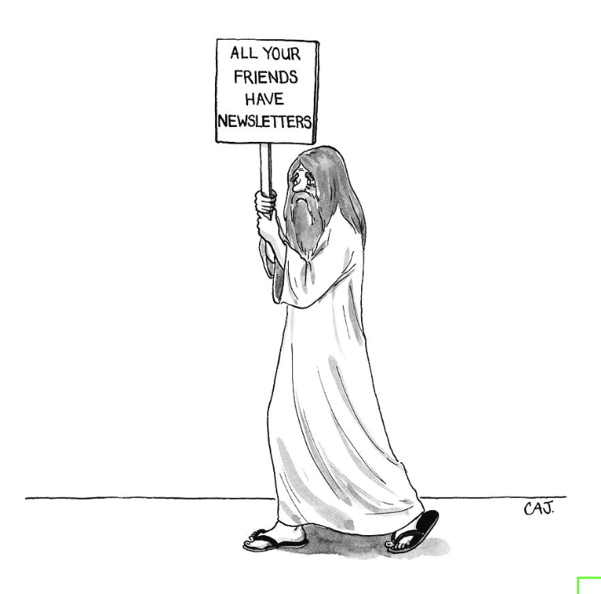
The big picture
Newsletter = email
Substack newsletter = email + a social platform/network effects/ Recommendation system
Carolita Johnson for The New Yorker
Notes:
Platforms are middle-people
Email is tried and true
Email has many purposes

Slide 5
The long game
Keep your network informed
Establish a regular public writing practice
Pilot ideas or practice forms
Share professional accomplishments
Connect with new/existing readers/contacts
Share other business/activities ops
Cross-post your own content
Publish supplementary writing to published works
Amplify your peers
Earn income*
Connect with other writers
Communicate more directly with Substack app readers
Benefit from the recommendation system
Benefit from the network effects
“A regular newsletter sent to your readers creates a long string of impressions, keeping your name at the forefront of their mind. When an opportunity arises, people are far more likely to think of you if they’ve frequently seen your name.”
Jane Friedman, The Business of Being A Writer pp. 191
*Be careful with this approach, can also be combined with all of the above
Notes:
Free email newsletters offer writers a range of benefits—a space to pilot ideas, publish supplementary writing to published works, share professional accomplishments, and connect with readers. Whether you're a published author or just getting started with creative writing, this workshop will bring you up to speed on how to use the tried-and-true staple of internet communication, email, to your advantage. We'll go over publication strategies that suit your longer-term goals and then get started with setting up your own newsletter.

Slide 6
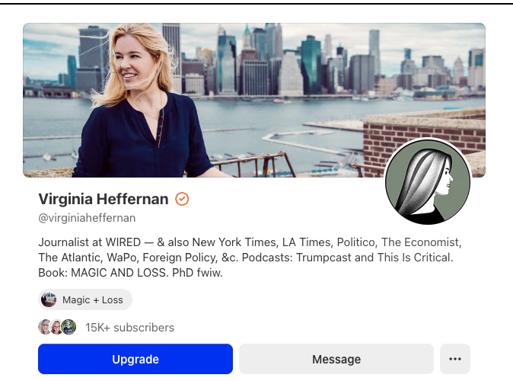
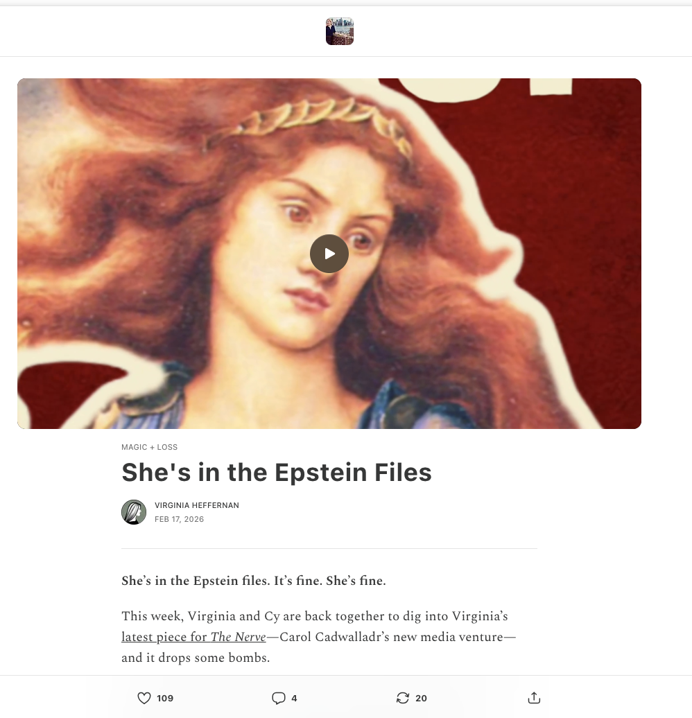
Keep your network informed
https://virginiaheffernan.substack.com/
Virginia Heffernan’s Substack also includes links to podcasts she’s on and book launch details
Notes:
Software: Mailpoet – a newsletter plugin for Wordpress websites ($)

Slide 7
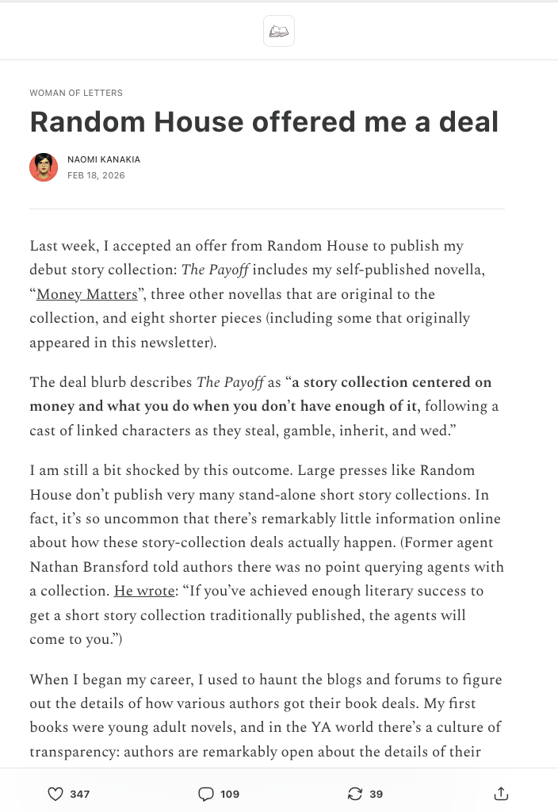
Share professional accomplishments
https://substack.com/@naomik
Woman of Letters | Random House post + Pilots new forms

Slide 8
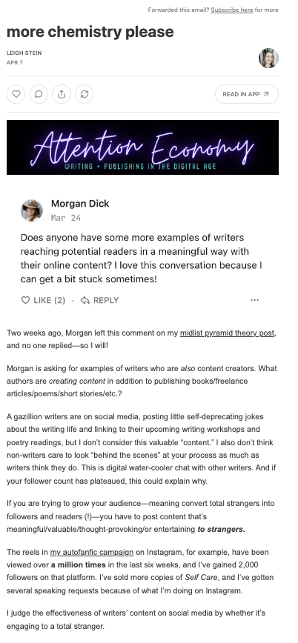
Connect with new/existing readers & Share other business offerings
Attention Economy | Leigh Stein
Here she creates a compelling entry out of a reader’s comment on a previous post
Attention Economy is Tips/tricks/essays notes from the field | describes her content strategy as a novelist, speaker, coach
https://leighstein.substack.com/p/more-chemistry-please
Notes:
Software: Substack
https://leighstein.substack.com/p/why-im-pivoting-to-substack

Slide 9
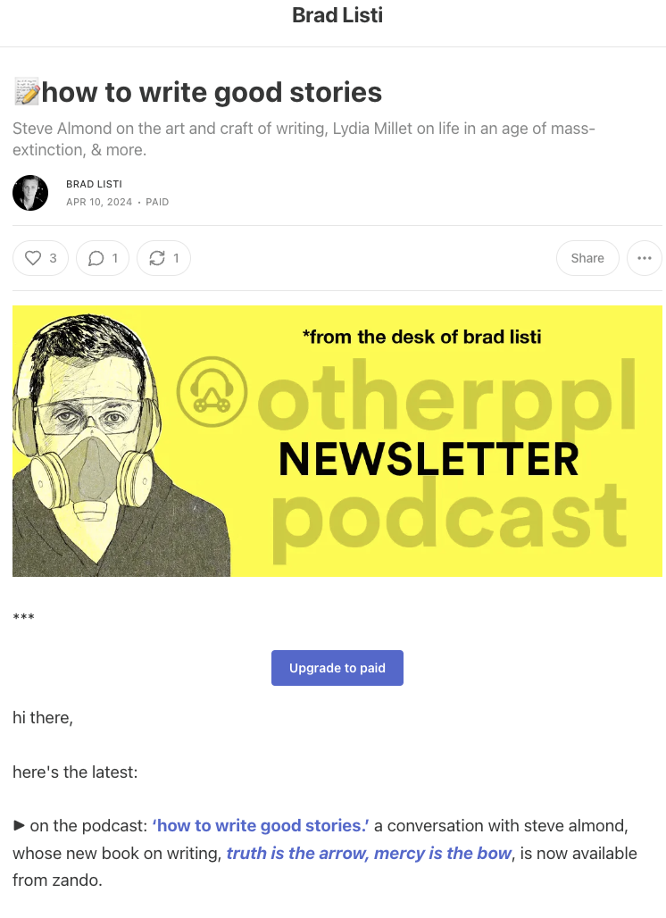
Cross-post your own content
otherppl podcast newsletter | Brad Listi
Weekly email announcing podcast content and fav reads
Easy cognitive load – all bullet points and emojis
https://bradlisti.substack.com/p/how-to-write-good-stories
Notes:
Software: Substack without URL masking

Slide 10
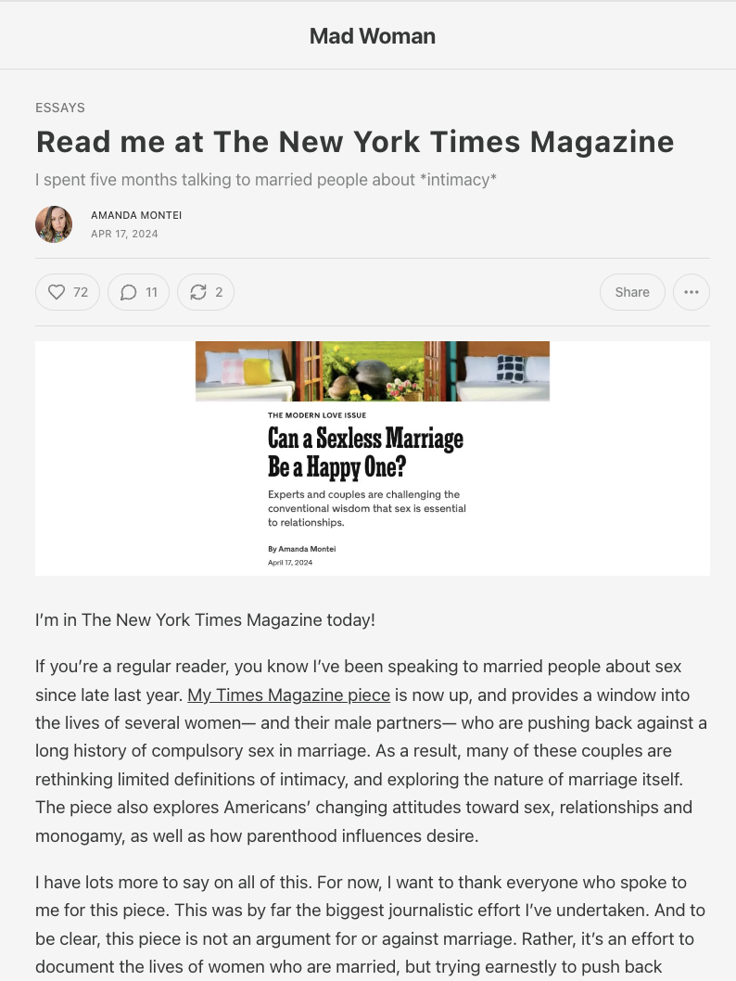
Cross-post your own content
Mad Woman | Amanda Montei
Here’s an example of her cross-posting her own content
She also writes long personal essays, reviews, interviews, reading group, writer’s circle + more
https://amandamontei.substack.com/p/read-me-at-the-new-york-times-magazine
Notes:
Software: Substack

Slide 11
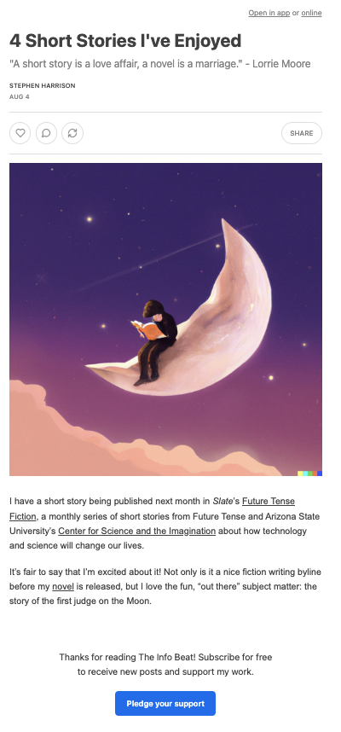
Supplementary material to published works
Source Notes | Stephan Harrison
Essays with greater detail about his writing and reporting work
Short story round-up as part of an announcement about his new short story (reminder)
https://notes.stephenharrison.com/p/4-short-stories-ive-enjoyed
Notes:
Software: Substack with URL masking ($)

Slide 12
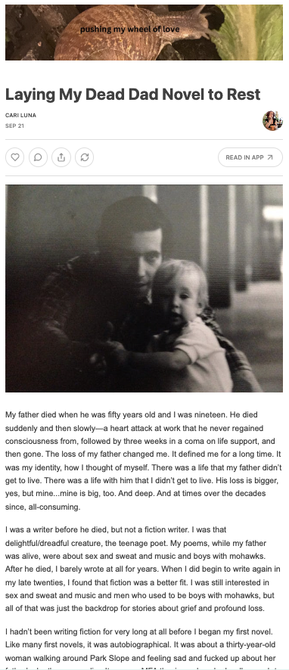
Supplementary material to published works
PILOTS NEW FORMS
Pushing my Wheel of Love | Cari Luna
Essays with greater detail about her process
Neighborhood walks
https://buttondown.com/cariluna (moved from Substack to Buttondown).
Notes:
Software: Substack

Slide 13
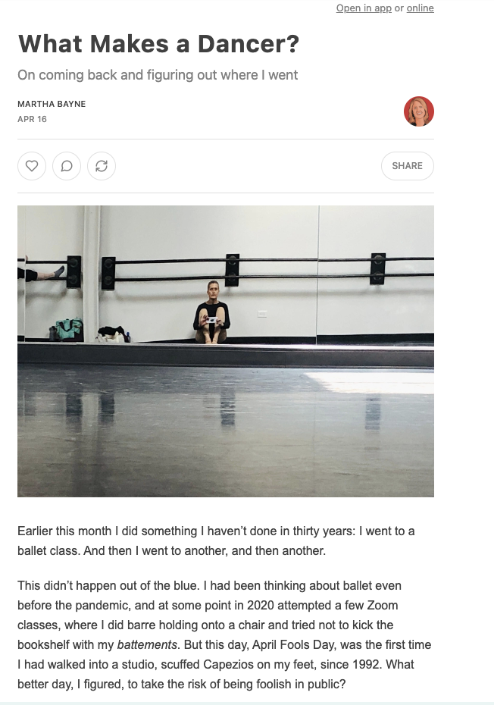
REGULAR WRITING
PILOT NEW forms
Bell, Whistle Range of Motion | Martha Bayne
Essays about living, cancer, ballet, dance, daily life from a former journalist who is now in academic publishing (acquisitions)
Notes:
Software: Substack

Slide 14
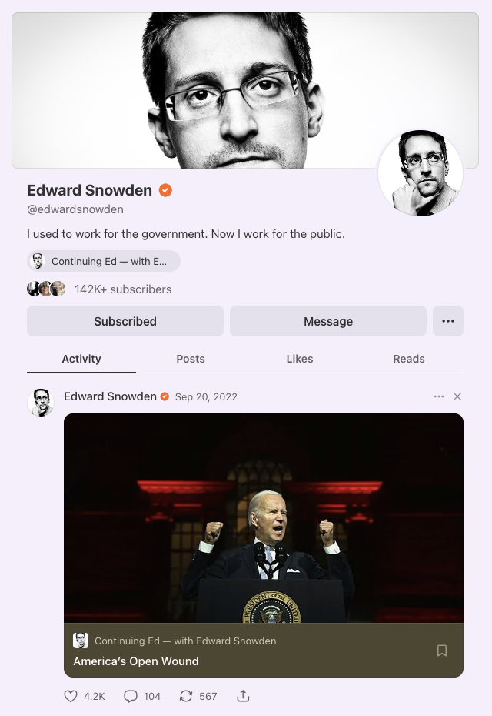
high anxiety content to build popularity | Build Thought leadership off of your own expertise elsewhere
Edward Snowden’s Substack
https://edwardsnowden.substack.com/
Notes:
Software: Convert Kit

Slide 15
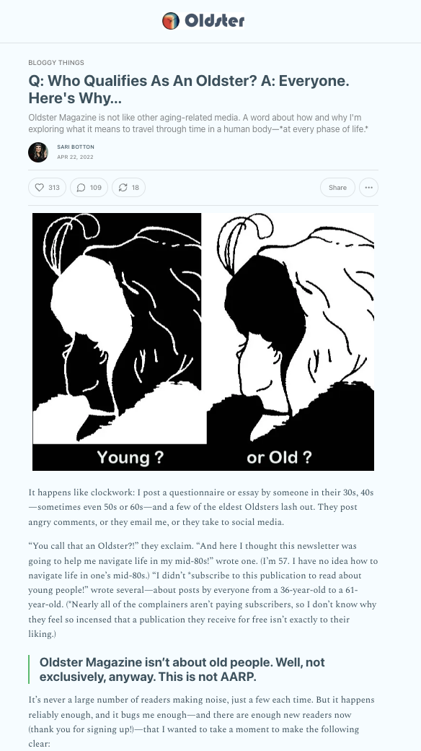
Amplify your peers
Oldster | Sari Botton
Essays about aging from everyone at every age
Has turned into a magazine!
https://oldster.substack.com/p/q-who-qualifies-as-an-oldster-a-everyone
https://substack.com/@saribotton
Notes:
Software: Substack
A magazine | Sari occasionally publishes her own work

Slide 16
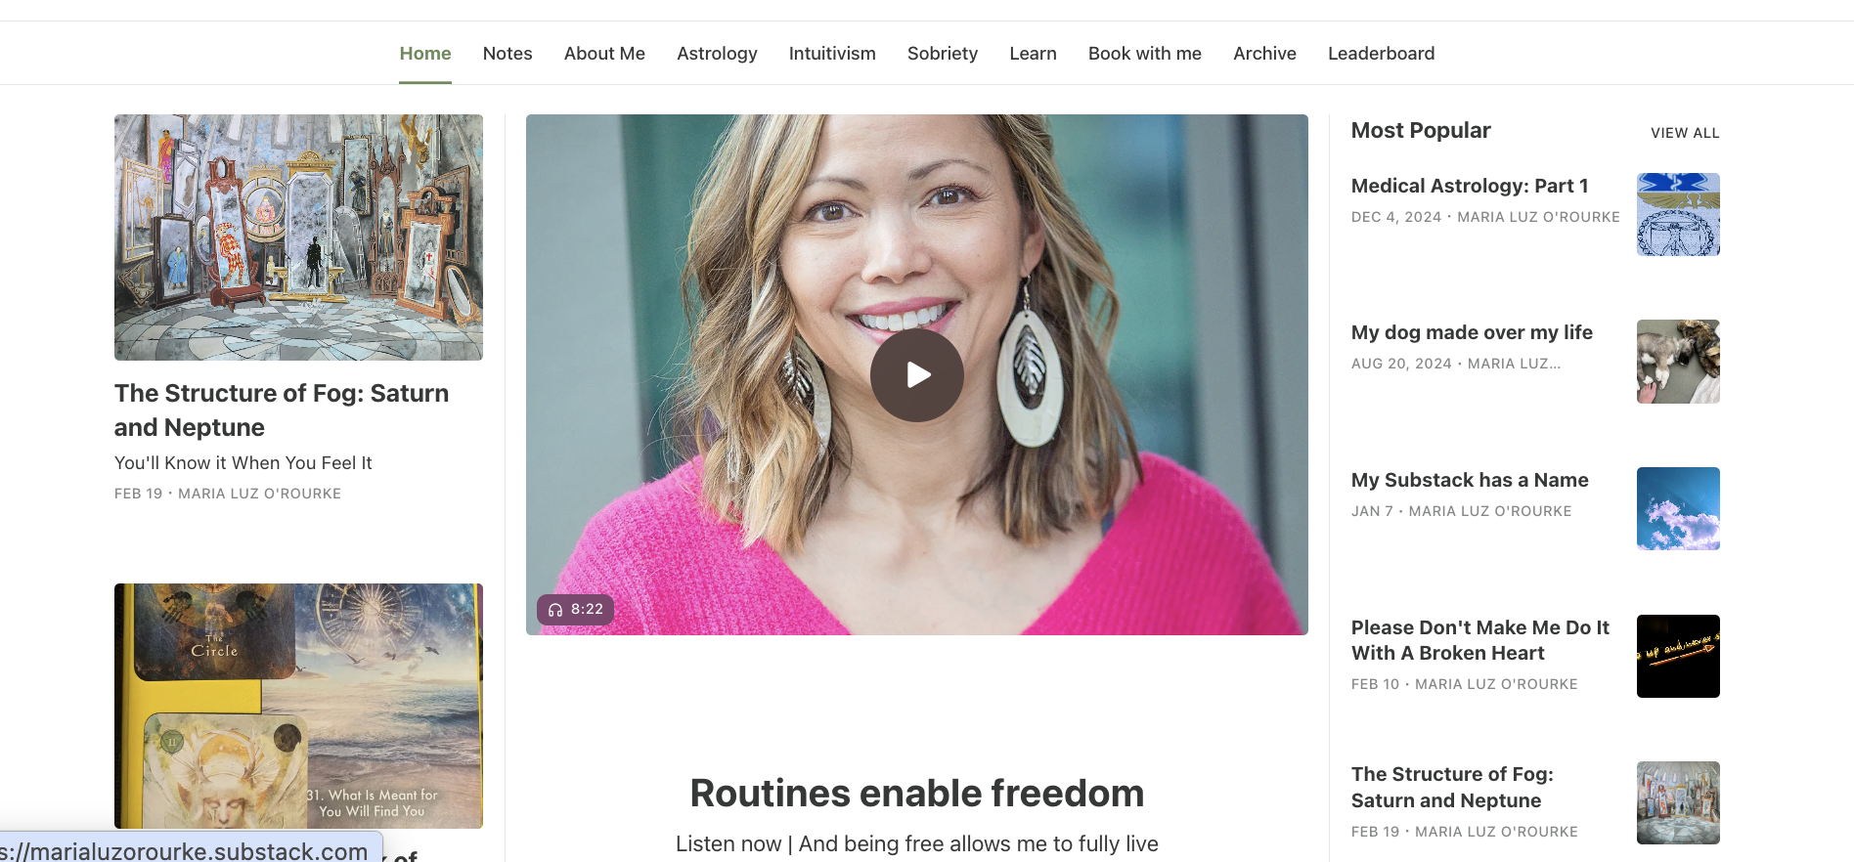
Maria Luz’s Newsletters
Write more than one newsletter
https://marialuzorourke.substack.com/
Notes:
Software: Substack

Slide 17
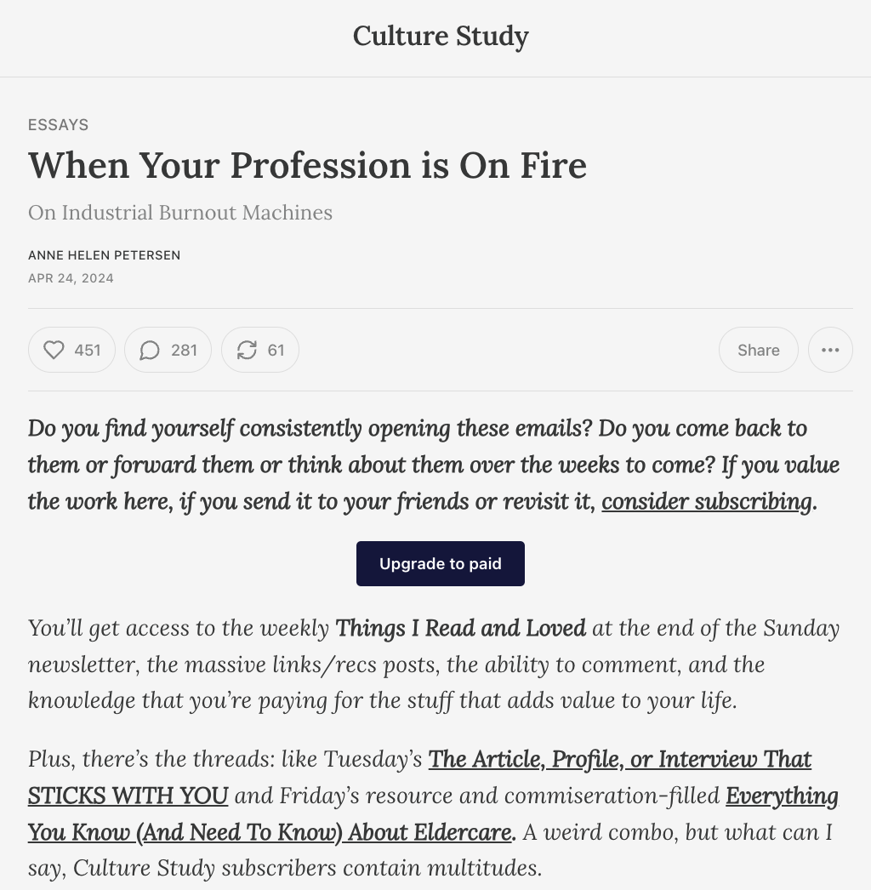
Earn income
Culture Study | Anne Helen Peterson
Sells subscriptions to her newsletter, podcast etc. much of the content free – some paywalled
Original essays, interviews, book reviews, Discord discussions, + more
https://annehelen.substack.com/
Notes:
Software: Substack

Slide 18
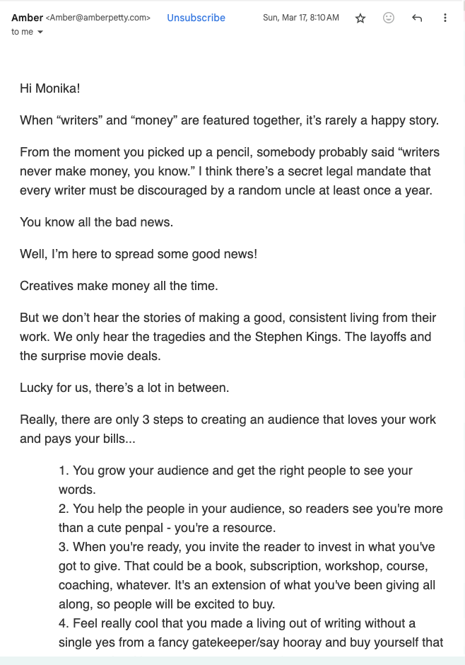
Earn income
Amber Petty
Helps writers | Sells consulting services, workshops, classes, materials
I took her free class “Your Newsletter Won’t Make Money .. And Why You Should Start One Anyway” and was convinced!
https://amber-petty.newzenler.com/courses/start-your-newsletter-get-people-to-read-it-1/
Notes:
Software: Convert kit
Your Newsletter Won't Make Money...And Why You Should Start One Anyway And was convinced!

Slide 19
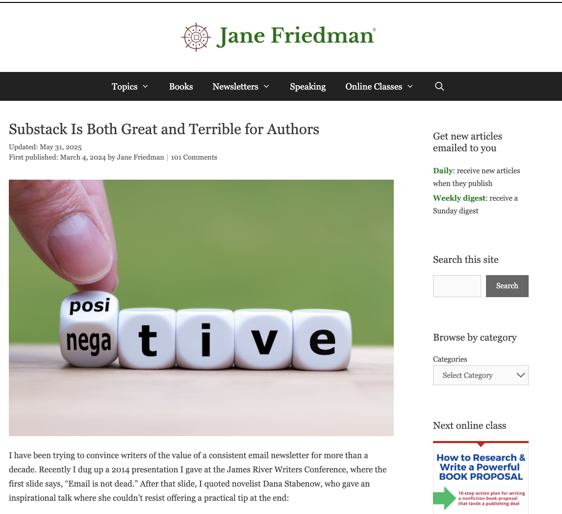
Words of wisdom from Jane about Substack and $ and hype
“There will always be more freeloaders than people willing to pay. The percentage of people who pay is typically around 1–5% of the people who read you for free”
Network effects and recommendation system
Substack is free and easy to use
Notes:
Altruism and paywalls
Software: convertkit.com

Slide 20
Digging deeper | What do you want to write about?
1. What do you think about/obsess about?
2. What dinner table topics are the most engaging for you that you want to go on and on about?
3. What do you search or ask ai about privately? What do you imagine other people are doing privately that might get them interested in your topic?
4. What topics or themes do you already write about that your readers might find interesting. Make a mind map around the writing you are already doing, to explore adjacent topics/themes to use for a newsletter.

Slide 21
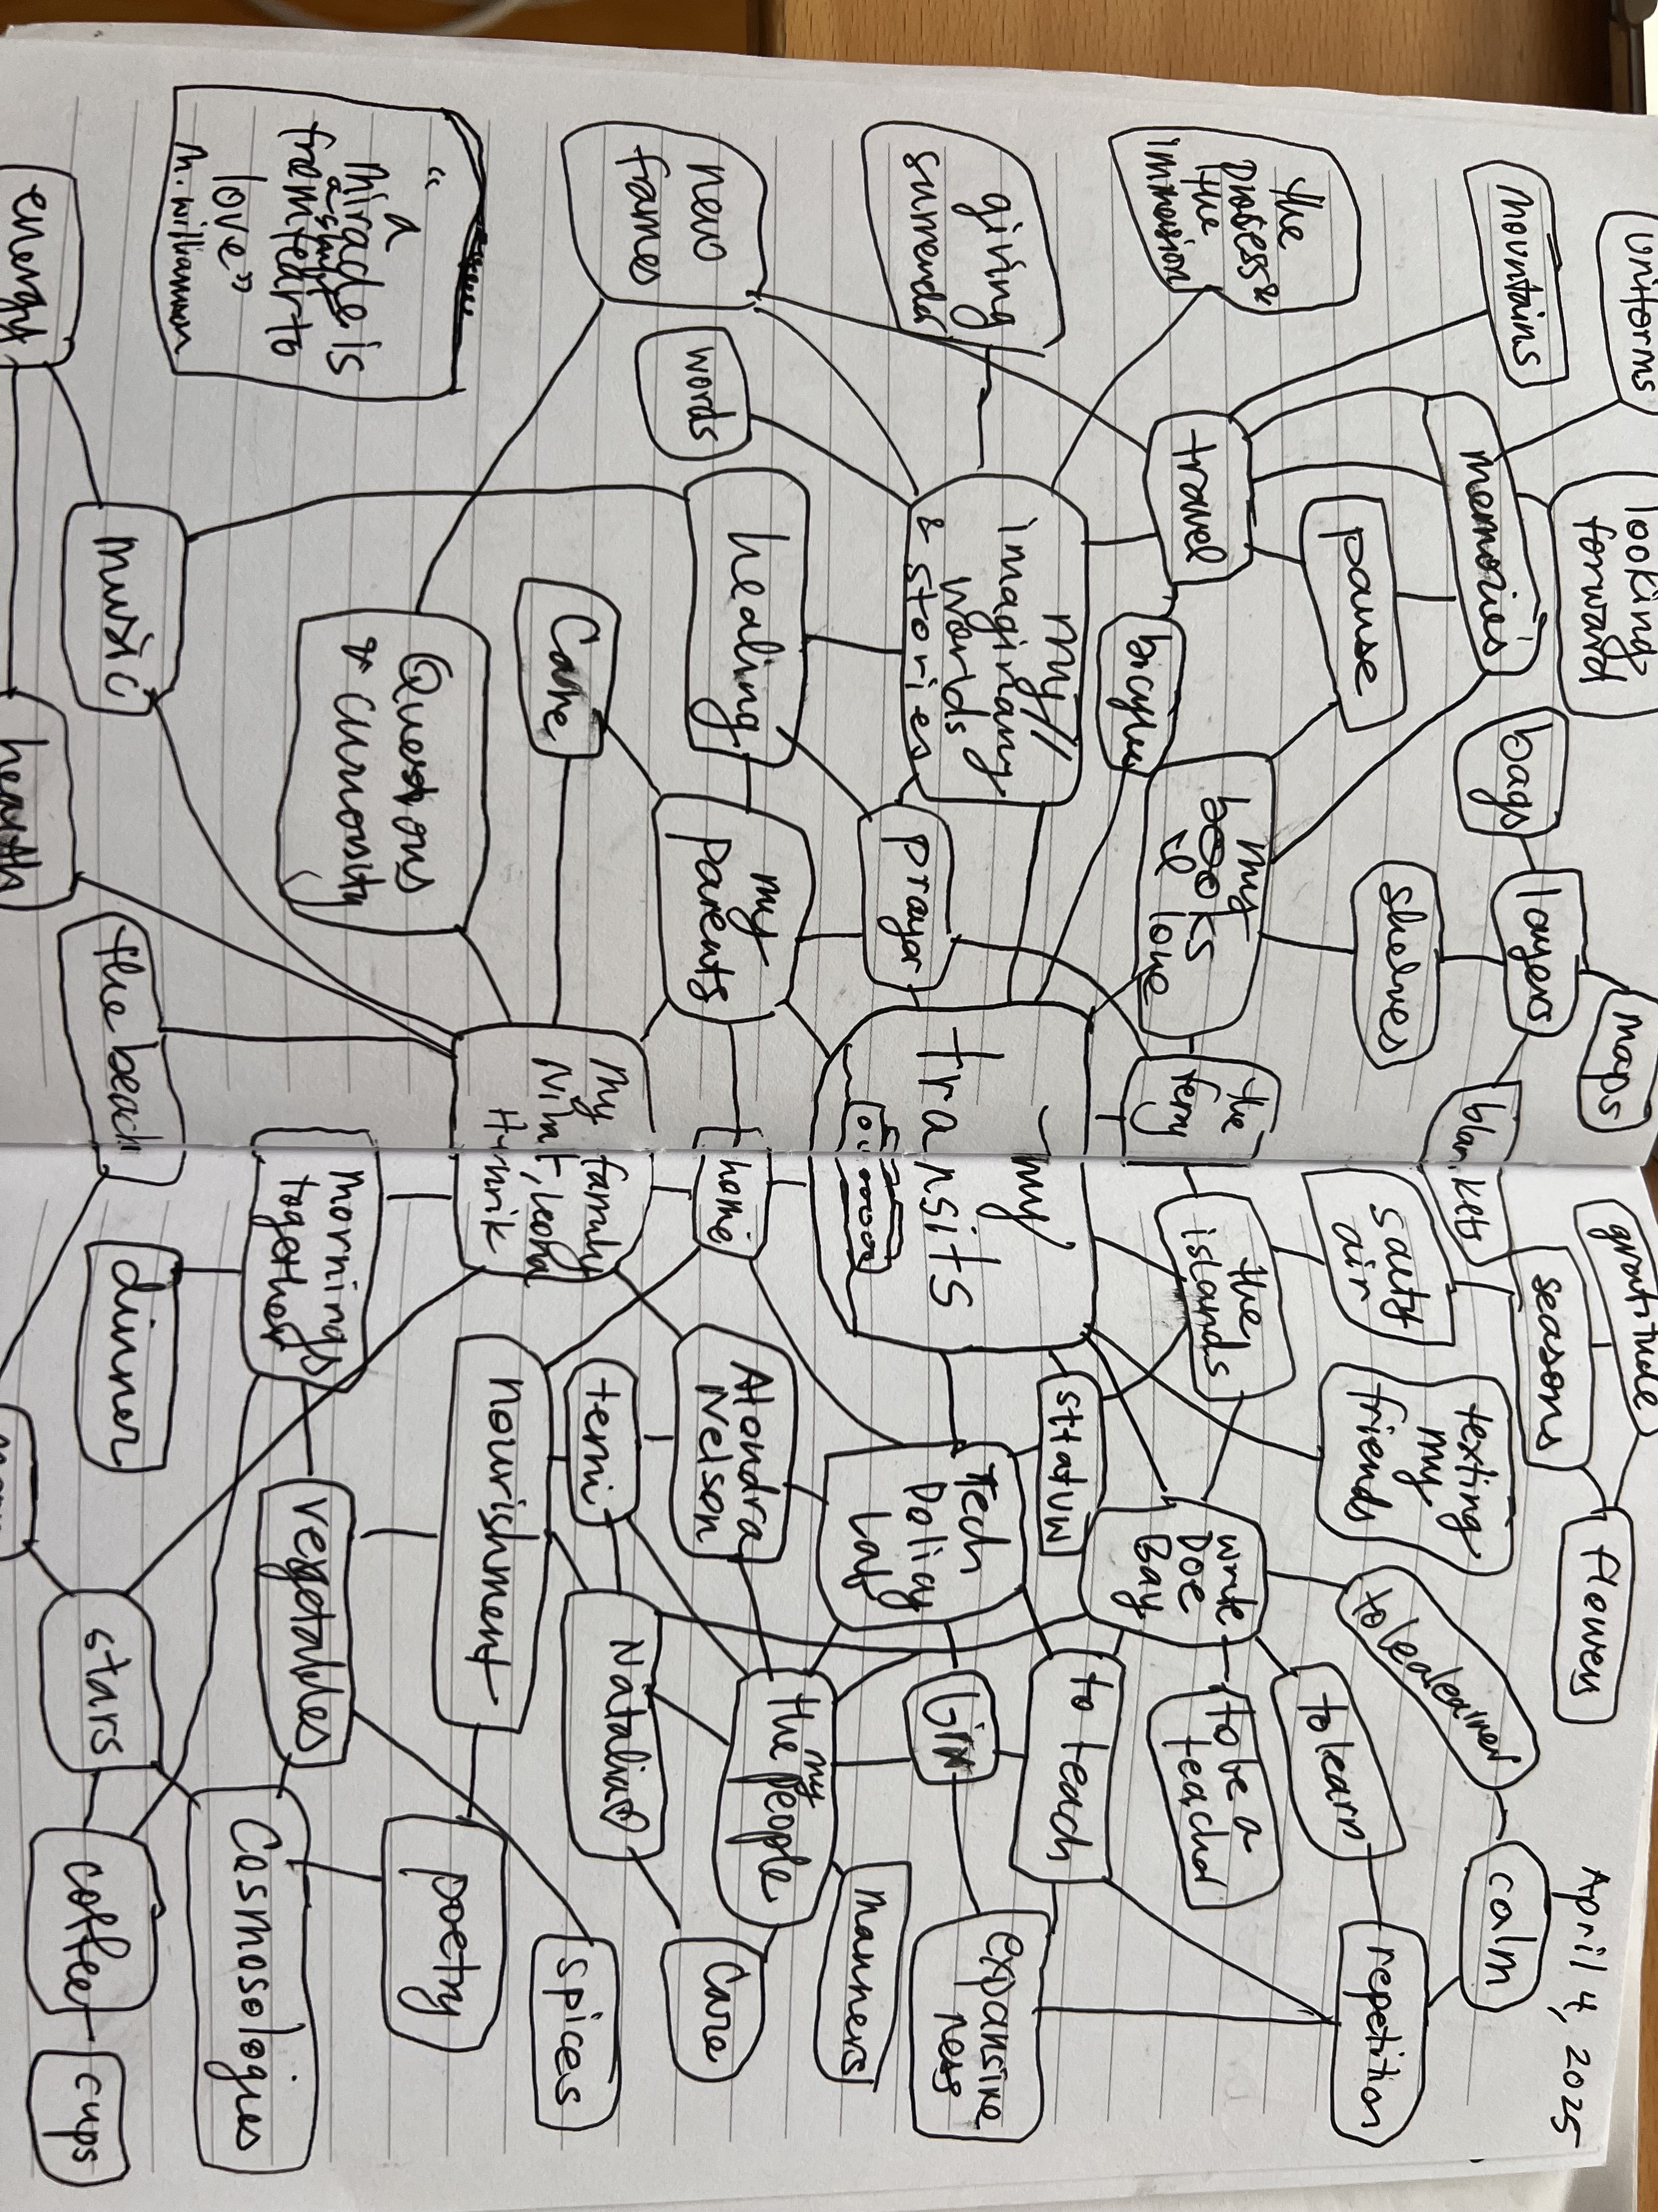
Mind map

Slide 22
Let’s get you set up | Worksheet | Homework
www.monikasjones.com/substack-workshop

